Slide 1
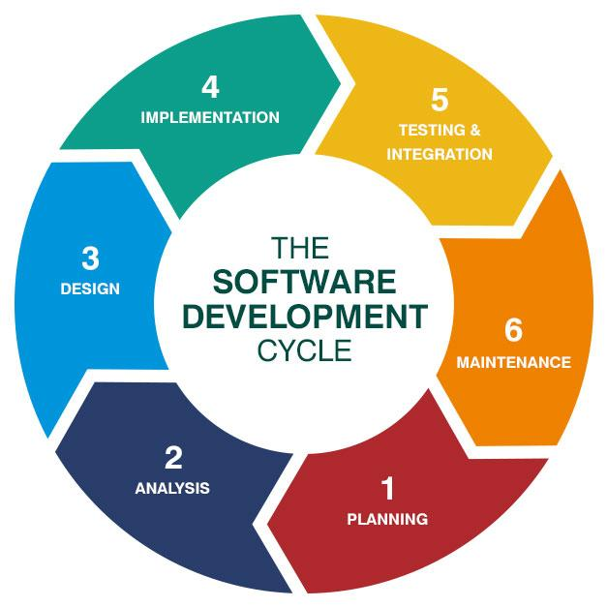
Software
Daniel Awbrey

Slide 2

Subteam Responsibilities
Data Acquisition
Data Communication
Data Visualization
Traction Control

Slide 3
Subteam Goals
Record data from onboard systems
Transmit sensor data for visualization
Display sensor data in a meaningful way that allows Engineers to track the health and performance of onboard systems
Increase traction electronically

Slide 4
Subteam Rules and Regulations
T.6.2.3 - Implausibility is defined as a deviation of more than 10% pedal travel between the sensors other failure as defined. If an implausibility occurs between the sensors accelerator pedal position sensors and persists for more than 100ms, the power to IC and EV motors must immediately shut down completely.
(EV only) It is not necessary to completely deactivate the Tractive System, the motor controller(s) shutting down the power to the motor(s) is sufficient

Slide 5
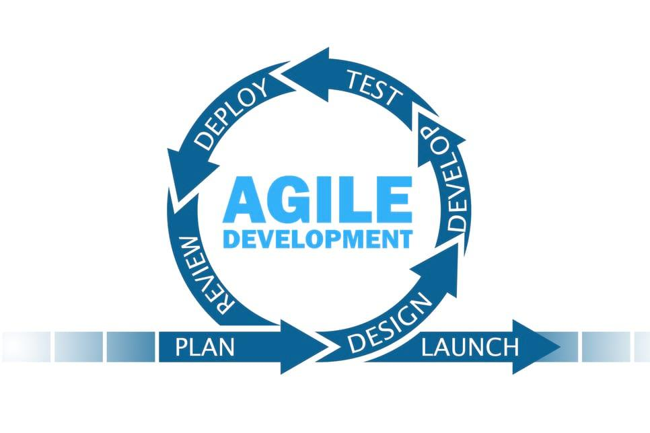
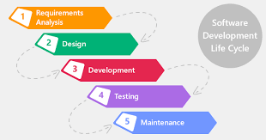
Design Planning Methodology in Computer Science
Design knowing requirements will change
90% of projects fail due to incomplete requirements or changing requirements
Waterfall produces rigid project structure ineffective at handling change
Agile favors product delivery for feedback instead of large planning process

Slide 6
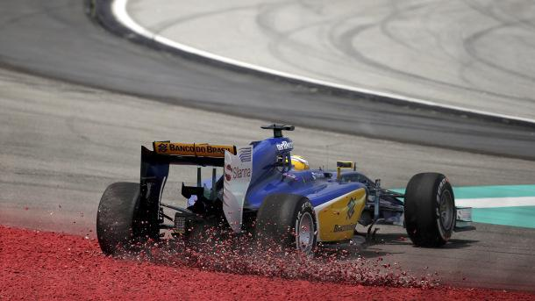
Traction Control

Slide 7
Traction Control: Design
Required sensors: 4 inductive velocity sensors
Optional controls: Dial to set maximum allowable wheel slippage
When embedded device detects that current wheel slippage exceeds driver or engineer defined wheel slippage amount spark or voltage is reduced to regain traction
Looking ahead: If brakes were electronically controlled or 4 motors powered each wheel (EV), a system could be implemented which would allow for control of an individual wheels slippage

Slide 8

Data

Slide 9
Requested Data Points
Data | Data source
Acceleration | Accelerometer
Motor temperature | Motor controller
Controls inputs | Potentiometer
Power | Motor controller
Suspension offset | Potentiometer
Aerodynamic load | N/A - calculated
Torque | N/A - calculated
RPM | Motor controller
Speed | Motor controller
Accumulator temperature | BMS
Battery charge | N/A - calculated
Water temperature | Thermostat
Gravitation forces | N/A - calculated
Tire temperature | Infrared
Brake temperature | Infrared
Traction | Inductive velocity sensors
Steering input | Analog steering sensor

Slide 10
Data Acquisition: Device Requirements
Sufficient sensor ports
Interfacing API
Satisfies weight limitations
Low power consumption
Multichannel device
Multi-signal input (analog & digital)
Compatible communication port
Preferably coaxial ports (adapters ok)
Rigidity

Slide 11
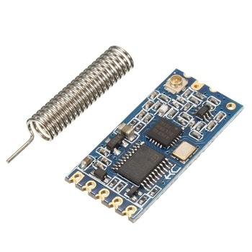
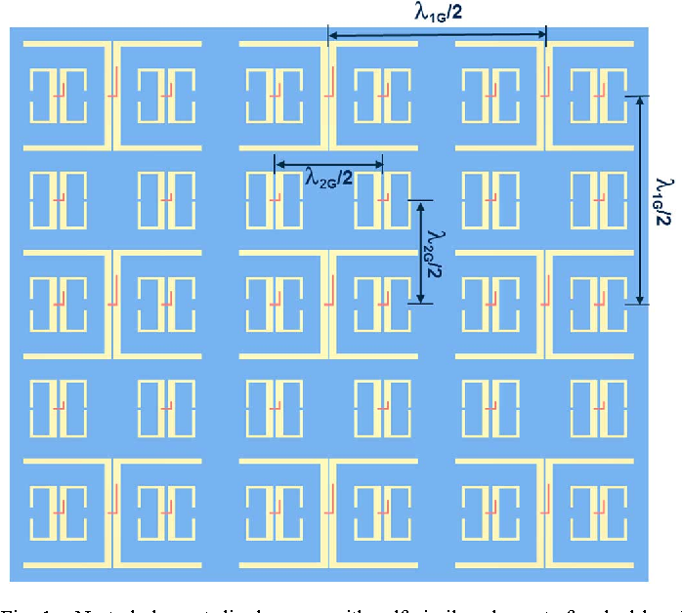
Data Communication: Wireless Devices
Long Range Transceiver vs Printed Antenna

Slide 12
Data Communication: Wireless Devices
Criteria | Long range transmitter | Printed antenna
Configuration (Hardware & Software) | 3 | 8
System complexity (Hardware) | 3 | 7
Acquisition | 6 | 3
Signal range | 2 | 2
Sufficient bandwidth | 5 | 5
Lightweight | 3 | 3
Low power consumption | 4 | 4
Cost | 6 | 2

Slide 13
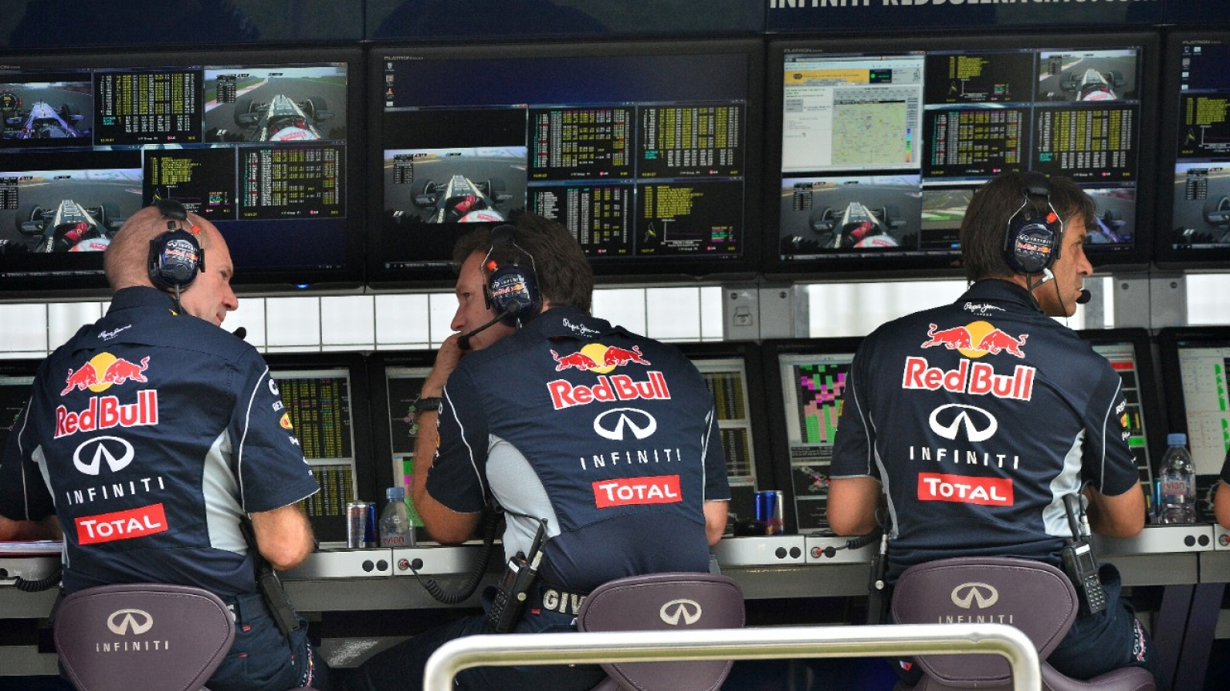
Data Visualization

Slide 14
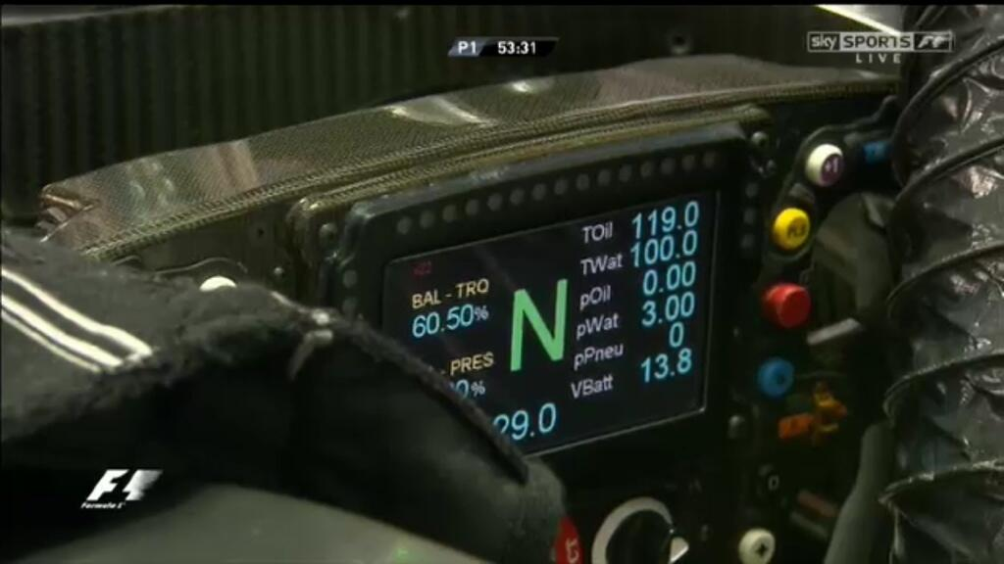
Data Visualization: Driver Display

Slide 15
Data Visualization: Driver Display
Necessary components: LED display, embedded controller, power supply
Ideal: Display powered by independent battery pack
Data
Speed
Accumulator temperature
Battery charge
Motor temperature
Voltage (low voltage)
Voltage (high voltage)
Water temperature
Torque
Speed
RPM

Slide 16
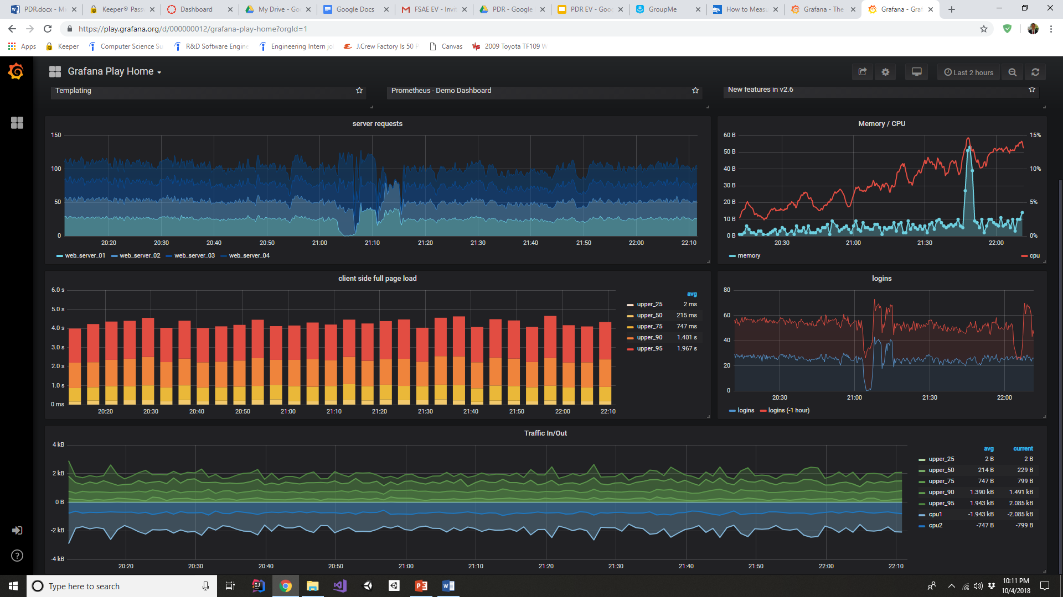
Data Visualization: Engineer Display

Slide 17
Data Visualization: Tools
Criteria | Grafana | D3
Software configuration | 5 | 4
Export capabilities | 6 | 2
Broad graphing utilities | 2 | 2
Community support | 5 | 4
Documentation clarity | 3 | 3
View Flexibility | 7 | 2

Slide 18
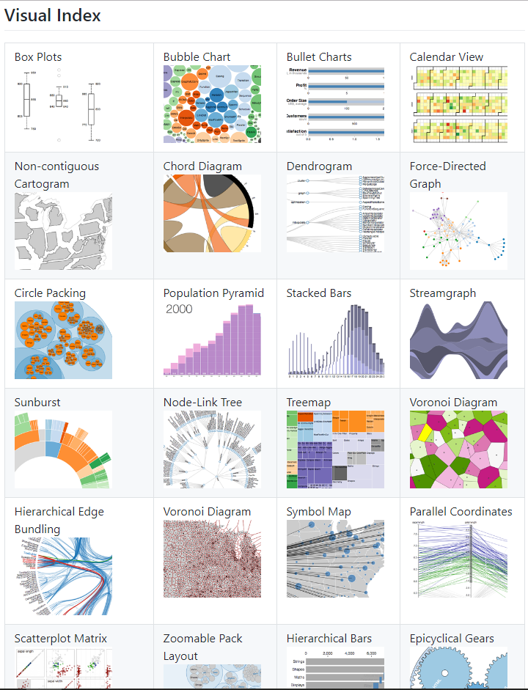
Data Visualization: D3 vs Grafana

Slide 19
New Opportunities & The Beauty of Software
Increased statistical analysis opportunities
Aerodynamic
Suspension
Provide the driver vehicle setup optimization inputs via control system
Aerodynamic optimization
Braking optimization
Runtime tuning
Electric motor tuning
Differential tuning
Battery management software
Motor controller software
Provide driver with race engineering data collected from practice sessions
Automate dynamometer software for reliability and performance testing

